Slide 1
Carbon-ML ecosystem and <CARML> standard
Steel Industry Use Case
November 2022

Slide 2
The Carbon-ML project is developing an extensible open-source ecosystem to provide declarations of measurements for embodied carbon in any product or service. Carbon-ML is incubated by Carbon Finance Labs in partnership with Oxy Low Carbon Ventures with a goal to rapidly evolve into an independently governed project.
We are a finance and technology incubator creating and implementing new climate change solutions. Our impact comes from using a global network of resources and knowledge built over decades spent in the carbon, finance and technology sectors globally.
Oxy Low Carbon Ventures, LLC (OLCV), a subsidiary of Occidental, Petroleum

Slide 3
Carbon-ML.org Vision
As the world becomes increasingly concerned with carbon emissions accelerating environmental and climate impacts, there is an increasing emphasis on understanding the amount of carbon equivalent emissions produced during the entire lifecycle of a product or service.
Our vision is for embodied carbon data to freely flow between all product or service-related system interactions across supply chains, while maintaining useful standardized contexts.
At any point along the supply chain there should be a digital embodied carbon equivalent (CO2e) .
Making this a reality means incorporating the work of others and building an open-source evolving solution.
Working with others, creating consortia of like-minded actors each with roles, use cases and responsibilities to provide input on development, usage and acceptance for fit for purpose solutions.

Slide 4
Carbon-ML.org Goals and Objectives
Our goal is to make embodied carbon data flows related to declaring & sharing easy, requiring:
An evolving ecosystem of actors.
Systems comprised of extensible schema referencing existing and evolving taxonomies.
A standard that is trusted, visible, open-source, adaptable, globally adoptable, and technology agnostic.
The customized creation of structured data declarations of measured embodied carbon (CO2e).
Enabling:
CO2e visibility for every product or service at any point along the supply chain.
Message Types containing information about the why, who, what, how, when, and where of the CO2e declaration, among other data reference points.
Empowering:
Private and public sector actors that produce, consume, govern, and track declarations of CO2e with maintainable, reasonable and standardized context for any product or service across supply chains.
Ecosystem partners to develop carbon related message types and related solutions such as displaying a product’s or service’s CO2e on its label/description.

Slide 5
Carbon-ML Ecosystem
Carbon-ML is envisioned as an evolving ecosystem of:
Global industry and services participants along with regulatory consortia
Extensible schemas of taxonomies maintained and versioned in an open but rigorous way
Open mix of technology, languages, tools and platforms for expression, usage and management
Governance principles for organization and growth to maximize data flow and message type usage
The proposed Carbon-ML Ecosystem includes consortia from distinct industry verticals, and from service organizations that provide leading practices and standards across multiple industries and services such as standards and taxonomy providers, technology service providers, regulators, NGOs etc. for accelerating the declaration of CO2e for any product and/or service at any point along a supply chain.
The primary open-source technical standard format to be used within the Carbon-ML ecosystem is <CarML> Carbon Messaging Language.

Slide 6
Carbon-ML Ecosystem Consortia Responsibilities
The goal of each Carbon-ML Ecosystem Industry Consortium is to form a consensus agreement as to the standard CO2e declaration message types to be used within their industry for the products or services at any point along the supply chain. Responsibilities include:
Providing expertise and work in shaping the resultant CO2e declaration Message Types
Active participation in working sessions and CO2e declaration message type development using <CarML>
Providing guidance on governance, existing taxonomies and structures, and incorporation of such
Assisting in shaping terms, reference data to be sourced, and definition of data fields
Assisting in promotional efforts, engaging others

Slide 7
Carbon-ML.org Responsibilities
Carbon-ML.org is the organization responsible for, among others:
The oversight and facilitation of the Carbon-ML Ecosystem Consortia
Maintenance of agreed upon governance, policies and procedures
The development of <CarML> Carbon Messaging Language and associated <CarML> Message Types and individual input fields that can be used on message types
The maintenance of the <CarML> Data Dictionary, generic APIs and other system entities, business rules, commands, etc.
Carbon-ML User Dashboard
Carbon-ML GitHub site
Promotion and marketing materials in conjunction with Carbon-ML Ecosystem Partners

Slide 8
What is <CarML> Carbon Messaging Language?
Carbon-ML.org is developing a standard language/format for CO2e Message Types, called <CarML> Carbon Messaging Language.
<CarML> is open-source and has been created to describe a standard technical format that uses human-readable language, text and syntax to store and communicate CO2e data between applications and end users.
The <CarML> extensible schema has been designed with adaptability in mind and is meant to evolve and extend as a framework, not being fully proscriptive of any one technology, solution, and/or interpretation.
A main goal of the Carbon-ML Ecosystem is to allow systems to exchange CO2e data through Message Types conforming to a global standard. <CarML> represents the language used to communicate inside such an ecosystem.
<CarML> is used to populate input fields on <CarML> Message Types.

Slide 9
What is a <CarML> Message Type?
A <CarML> Message Type displays CO2e related product or service information, such as company, product, CO2e amount, measurement methodology, date and time, who created and who verified, location, transaction, environmental offsets, and any other user and consumer determined information. And it can also include links to detailed reports or other information.
<CarML> Message Types individual data input fields are populated using the <CarML> standard format
There are several ways to create a <CarML> Message Type, by accessing the <CarML> User Dashboard and selecting from:
Pre-built <CarML> Message Type templates
<CarML> Message Type Form Builder
Combination of pre-formatted <CarML> data form fields and user created form fields

Slide 10
The <CarML> User Dashboard
To ensure transparency and ease of use, when a user signs-on to the <CarML> system there will be a user-friendly dashboard display containing the following:
Links to previous <CarML> Message Types created by the user
Links to the <CarML> Data Dictionary
Links to <CarML> Message Type Formats
Links to the <CarML> Message Type Builder which will allow the user to select unique data fields and create a customized <CarML> Message Type that is fully compatible with the <CarML> standard.
Option of uploading user-created <CarML> standard data fields to the “User” section of the Carbon-ML GitHub site. Once user created entities have been approved by the relevant Carbon-ML Ecosystem Consortium, they will be moved to the official <CarML> approved standard area of the GitHub site and reflected in the <CarML> Data Dictionary.

Slide 11
How Does <CarML> Work?
In the most basic sense, <CarML> would be used when populating data fields on a form in a <CarML> standardized data format.
In order to populate a specified field with the correct data, several components need to be in place:
Each data field on a form needs to have an agreed upon definition of the context, data type, structure of the data, etc. These definitions are maintained in an easily accessible data dictionary. Relevant fields and definitions will be approved by each Carbon-ML Ecosystem Consortium and maintained by Carbon-ML.org.
To automatically populate a field, <CarML> would reference the definition and a unique API would be built to fetch the data from the database on which it resides. Currently, Carbon-ML.org is building generic RESTful APIs in both a JSON and an XML format for each unique field in the form. In the future, GraphQL APIs will be provided as well. The endpoints are unique to each user, and must be specified by the user.

Slide 12
How Does <CarML> Work continued?
Other features of <CarML>:
For each data field and unique API there will also be an embedded compliance check to ensure the data is following the agreed structure and appears reasonable.
As forms may have multiple fields, each pertaining to the same product or service, <CarML> also includes a “Product ID” field on each API that can be automatically populated with the designated Product ID once all fields are selected for a given form. Without this context, there is no way of knowing what information on databases is related to what product and the data returned would be meaningless.
The <CarML> APIs unique to each field can be thought of as housing an entity object which embodies a small set of critical business rules, commands, etc which operate to return the required data.
There are other APIs which run at a higher level providing needed services to the entirety of the <CarML> system, giving <CarML> its own hierarchy/taxonomy.
All information will be accessible on the Carbon-ML GitHub site.

Slide 13
Carbon-ML Steel Industry Consortium
Carbon-ML.org is bringing together leaders from the Steel Industry to participate in the Carbon-ML Ecosystem Steel Industry Consortium, and we are looking for partners to help lead and frame the consortium.
Goals would be to define use cases for <CarML> Message Types pertinent to the Steel Industry utilizing existing schemas, taxonomies, EPDs, etc.
Carbon-ML.org would help facilitate discussions; define user requirements; and develop the User Dashboard, <CarML> data fields and definitions, <CarML> Steel Industry Message Types, among others.
The first meeting of the Steel Industry Consortium is tentatively scheduled for mid-January 2023.
A illustrative Steel Industry Use Case follows.

Slide 14
Carbon-ML Steel Industry Use Case Example
Commercial construction
Declared product and declared unit: Open web steel joists and joist girders, 1 metric ton
Source information: EPD Open Web Steel Joists and Joist Girders issued by the Steel Joist Institute, January 21, 2022
<CarML> Steel Message Types:
Raw Materials Supply: Steel coils, angles, channels production
Transportation of raw materials
Manufacturing: Joist manufacturing
<CarML> CBAM Message Type

Slide 15
<CarML> Steel Use Case Message Types – Supply Chain Steps
Use Case for Steel (all data and inputs are for illustration purposes only): Commercial Builders Inc. orders K-Series Steel Joists from ABC Steel Joists Co. who in turn orders Cold Rolled Steel Coils from Steel Coils-R-Us and Industrial Shippers Inc. is contracted for transport of the Cold Rolled Steel Coils.
Steel Coils-R-Us manufactures the Cold Rolled Steel Coils and creates a <CarML> Raw Materials Message Type providing CO2e and other information about the product.
Industrial Shippers Inc. receives the Cold Rolled Steel Coils shipment and the <CarML> Message Type and prepares transport of the product to ABC Steel Joists Co.
Industrial Shippers Inc. creates a <CarML> Transportation Message Type for the transport of the product and includes the Raw Materials Message Types as well. All is delivered to ABC Steel Joists Co.
ABC Steel Joist Co. Manufacturers the K-Series Web Steel Joists and creates a <CarML> Manufacturing Message Type. The K-Series Web Steel Joists are ready for Commercial Builders Inc. with the <CarML> Message Types attached.

Slide 16
<CarML> Steel Raw Materials Message Type
General provides information on the supplier, Steel Coils-R-Us and the product being supplied including quantity and some basic attributes.
The Unique ID is an ID which is unique to the specific product type, Cold Rolled Steel Coils 60 gauge and 16 grade.
Amount is the amount of the declared trait which is CO2e related to the manufacture of the Cold Rolled Steel Coils
The Amount section also includes a Total Amount of CO2e which will increase as the product moves along the supply chain
Event is the process that is occurring during this step and what is being supplied. The date/time fields denote the time required to complete the event.
Location of Event is where the manufacture of the Cold Rolled Steel Coils took place

Slide 17
<CarML> Steel Raw Materials Message Type continued
Declared Trait Data Source summarizes from where the information about the CO2e was provided.
In this use case the CO2e amount was from a CarbonSig report referencing the EPD Open Web Steel Joists and Joist Girders issued by the Steel Joist Institute, January 21, 2022, declaration number 4789985166.101.1.
The measurement methodology provides summary information from the EPD as to how the CO2e was calculated.
The Verifying Entity would be an external, certified audit firm that is qualified to certify the CO2e calculation method and amount.

Slide 18
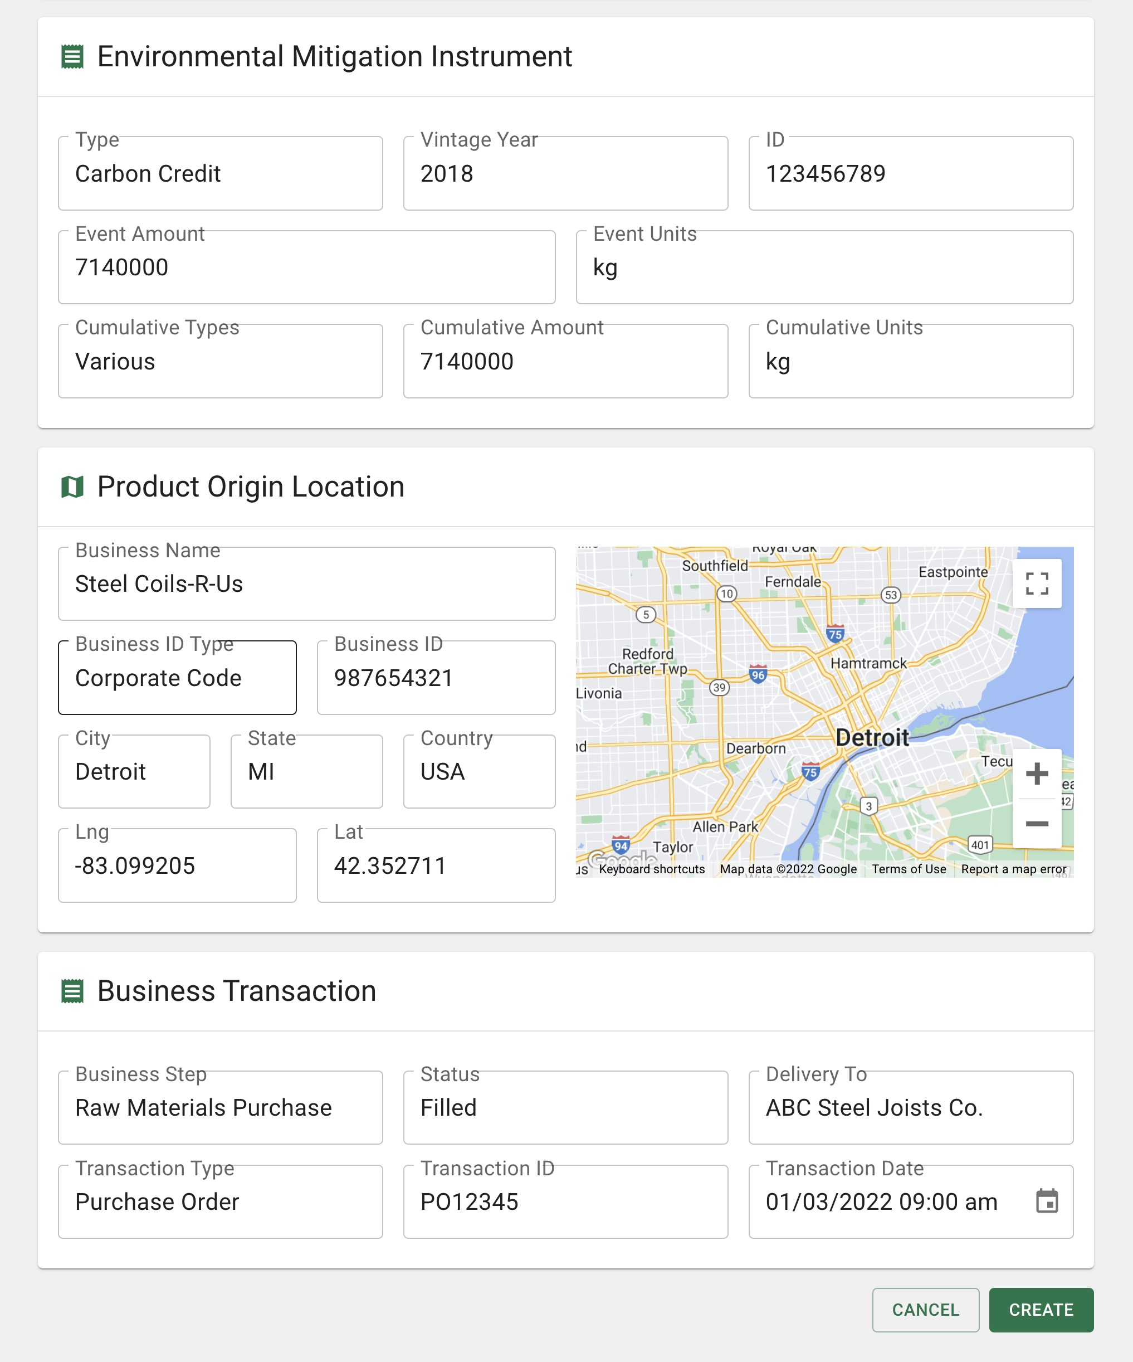
<CarML> Steel Raw Materials Message Type continued
Environmental Mitigation Instrument provides summary information regarding any offsets that were purchased and allocated to this product.
For the Raw Materials, Steel Coils-R-Us purchased enough offsets so that this order resulted in a carbon neutral product supply.
The Product Origin Location remains consistent throughout the supply chain journey so that one can always reference where the raw materials and journey started. For this use case, the product origin will be Steel Coils-R-Us throughout the supply chain and other <CarML> Message Types.
The Business Transaction is a reference for the supplier and purchaser and provides additional details regarding the transaction that may be relevant to them.

Slide 19
<CarML> Steel Transportation Message Type
General provides information on the supplier, Industrial Shippers Inc., and the product being transported including quantity and some basic attributes.
The Unique ID is an ID which is unique to the specific product type, Cold Rolled Steel Coils 60 gauge and 16 grade.
Amount is the amount of the declared trait which is CO2e related to the transportation of the Cold Rolled Steel Coils.
The Amount section also includes a Total Amount of CO2e which has increased as the product moved along the supply chain.
Event is the process that is occurring during this step and what is being supplied. The date/time fields denote the time required to complete the event.
Location of Event is the headquarters of Industrial Shippers Inc. who transported the Cold Rolled Steel Coils

Slide 20
<CarML> Steel Transportation Message Type continued
Declared Trait Data Source summarizes from where the information about the CO2e was provided.
In this use case the CO2e amount was from a CarbonSig report referencing the EPD Open Web Steel Joists and Joist Girders issued by the Steel Joist Institute, January 21, 2022, declaration number 4789985166.101.1.
The measurement methodology provides summary information from the EPD as to how the CO2e was calculated.
The Verifying Entity would be an external, certified audit firm that is qualified to certify the CO2e calculation method and amount.

Slide 21
<CarML> Steel Transportation Message Type continued
Environmental Mitigation Instrument provides summary information regarding any offsets that were purchased and allocated to this product.
For the Transportation, Industrial Shippers Inc. purchased enough offsets so that this order resulted in a carbon neutral product supply. In addition, the cumulative amount reflects the purchase by Steel Coils-R-Us and shows that this is a carbon neutral product supply.
The Product Origin Location remains consistent throughout the supply chain journey so that one can always reference where the raw materials and journey started. For this use case, the product origin will be Steel Coils-R-Us throughout the supply chain and other <CarML> Message Types.
The Business Transaction is a reference for the supplier and purchaser and provides additional details regarding the transaction that may be relevant to them.

Slide 22
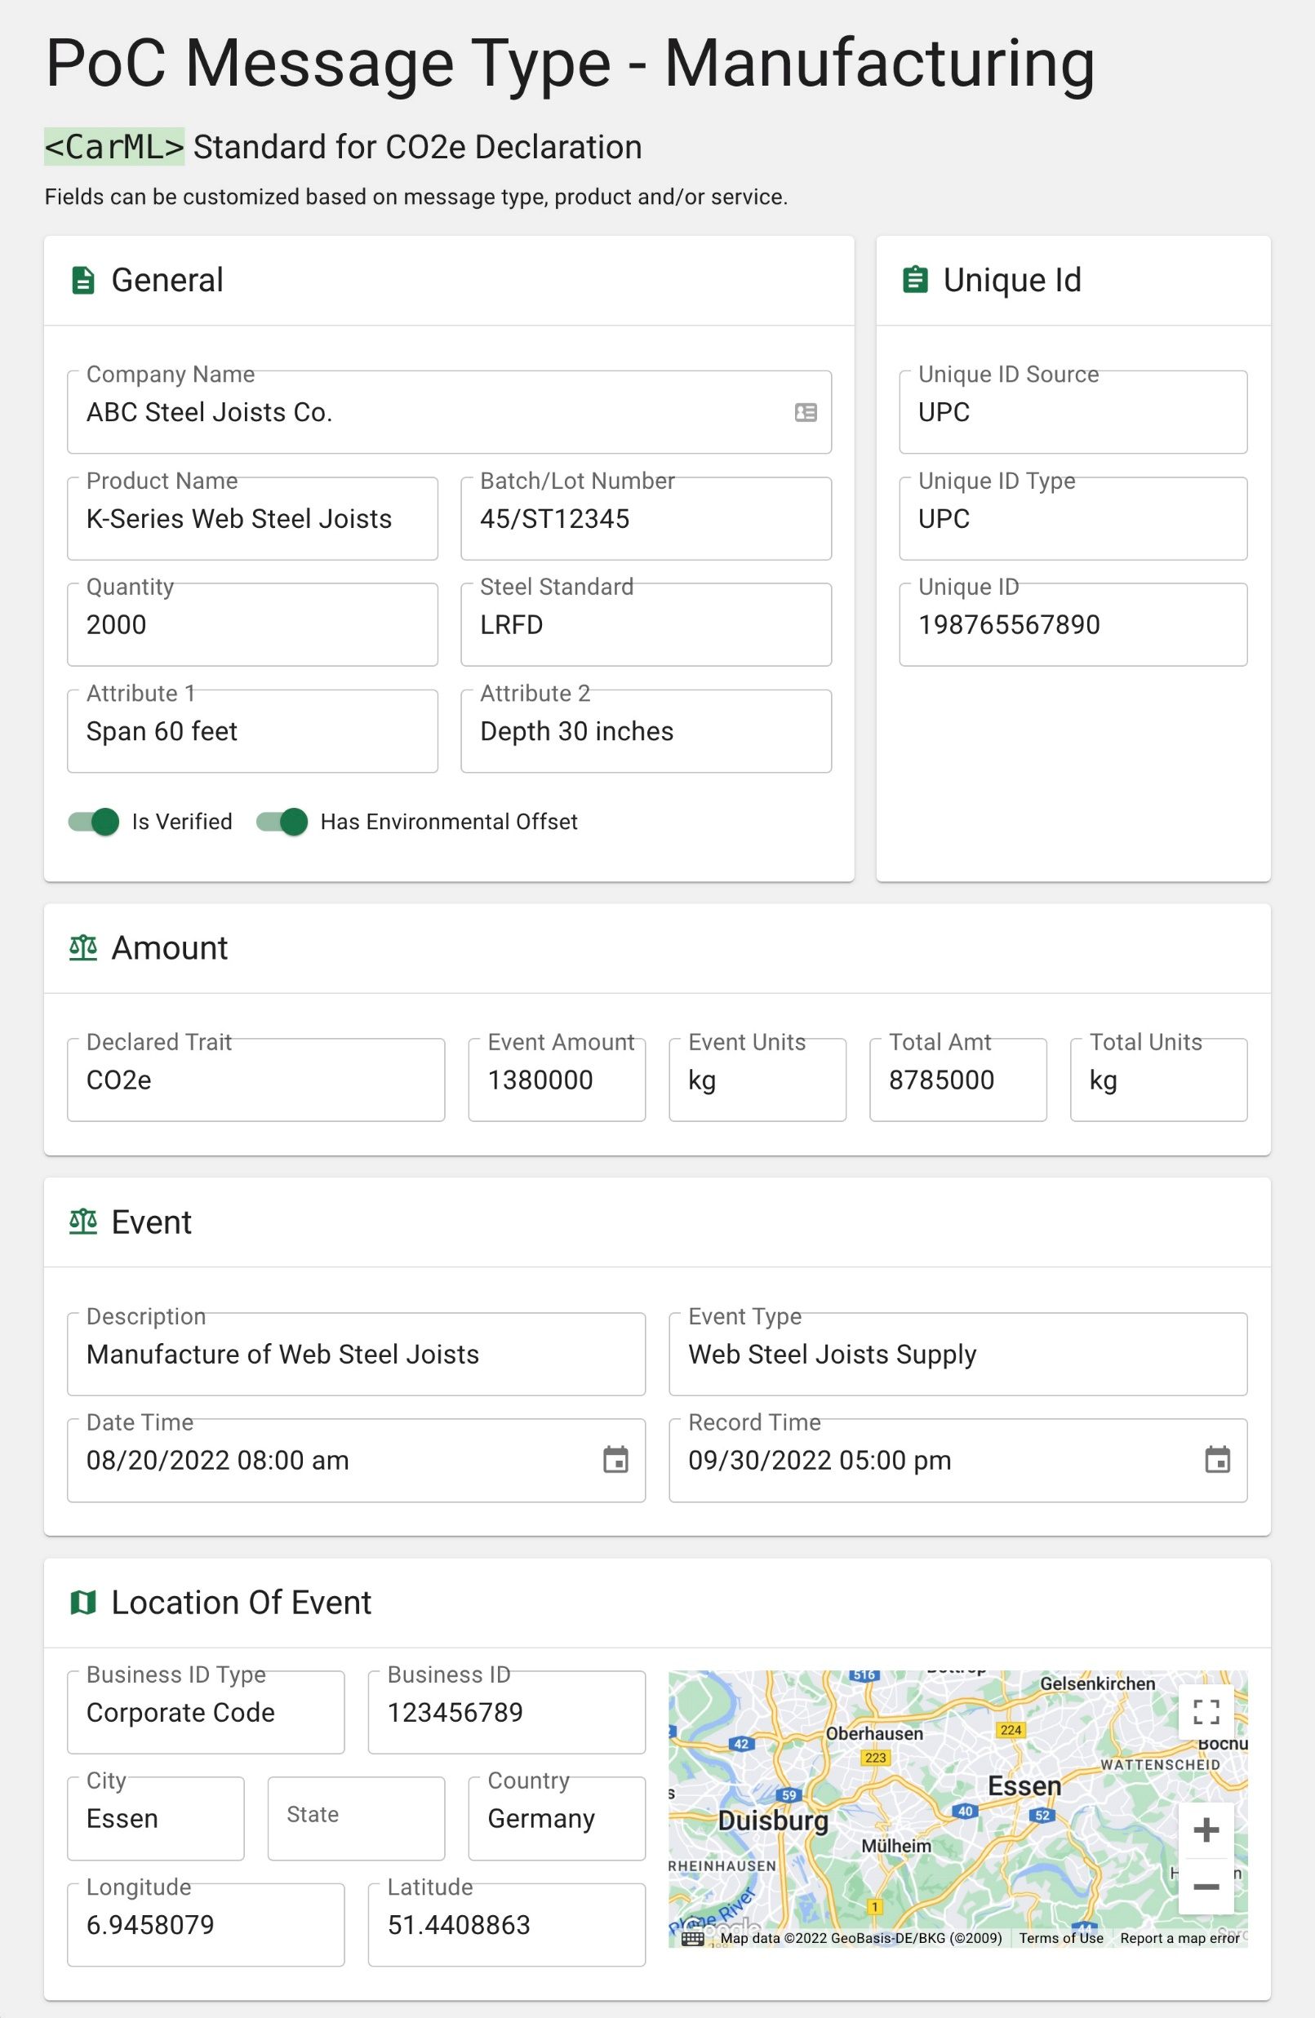
<CarML> Steel Manufacturing Message Type
General provides information on the supplier, ABC Steel Joists Co., and the product being supplied including quantity and some basic attributes.
The Unique ID is an ID which is unique to the specific product type, K-Series Web Steel Joists with 60 ft span and 30 in depth.
Amount is the amount of the declared trait which is CO2e related to the manufacture of the K-Series Web Steel Joists
The Amount section also includes a Total Amount of CO2e which has increased as the product moved along the supply chain
Event is the process that is occurring during this step and what is being supplied. The date/time fields denote the time required to complete the event.
Location of Event is where the manufacture of the K-Series Web Steel Joists occurred.

Slide 23
<CarML> Steel Manufacturing Message Type continued
Declared Trait Data Source summarizes from where the information about the CO2e was provided.
In this use case the CO2e amount was from a CarbonSig report referencing the EPD Open Web Steel Joists and Joist Girders issued by the Steel Joist Institute, January 21, 2022, declaration number 4789985166.101.1.
The measurement methodology provides summary information from the EPD as to how the CO2e was calculated.
The Verifying Entity would be an external, certified audit firm that is qualified to certify the CO2e calculation method and amount.

Slide 24
<CarML> Steel Manufacturing Message Type continued
Environmental Mitigation Instrument provides summary information regarding any offsets that were purchased and allocated to this product.
For the Manufacturing, ABC Steel Joists Co. did not purchase any offsets so the cumulative amount does not change and is reflective of the previous purchases by Steel Coils-R-Us and Industrial Shippers Inc.
The Product Origin Location remains consistent throughout the supply chain journey so that one can always reference where the raw materials and journey started. For this use case, the product origin will be Steel Coils-R-Us throughout the supply chain and other <CarML> Message Types.
The Business Transaction is a reference for the supplier and purchaser and provides additional details regarding the transaction that may be relevant to them.

Slide 25
<CarML> Steel Use Case Supply Chain Journey QR Code

Slide 26
QUESTIONS?

Slide 27
Carbon-ML Core Team:
Nick.Gogerty@carbonfinancelab.com
Lynn.Connolly@carbon-ml.org
Rene.Monroy@carbon-ml.org
info@carbon-ml.org
www.carbon-ml.org

