Slide 1
Why Low-Rise?
At least 50% of what gets built in North America
Less reliant on structural concrete and steel
More material options & competition
More existing carbon-storing options
Less barriers to innovation
Large group of forward-looking practitioners
Actively transforming low-rise practices to become climate positive as quickly and intelligently as possible.

Slide 2
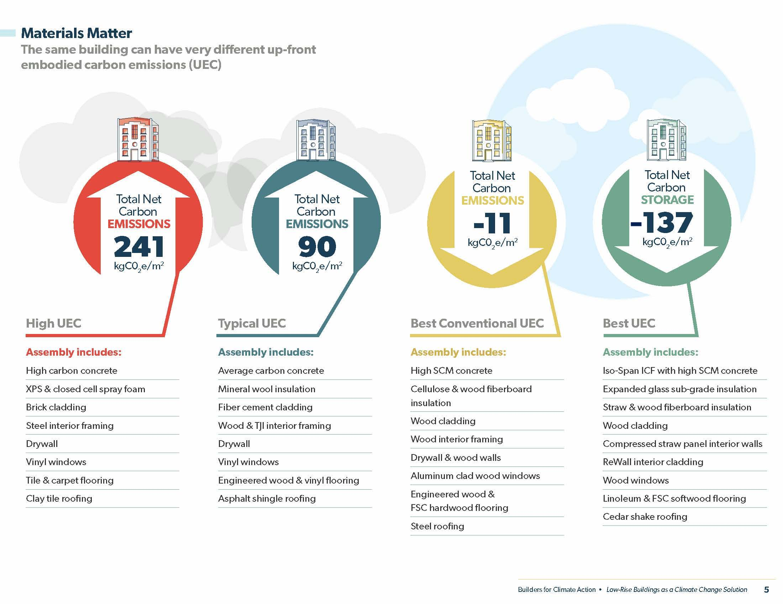
2019
White paper study sponsored by local municipality, architects & builders.
Based on study results of bungalow and 4-storey MURB models.
Results show potential for net carbon storage.

Slide 3
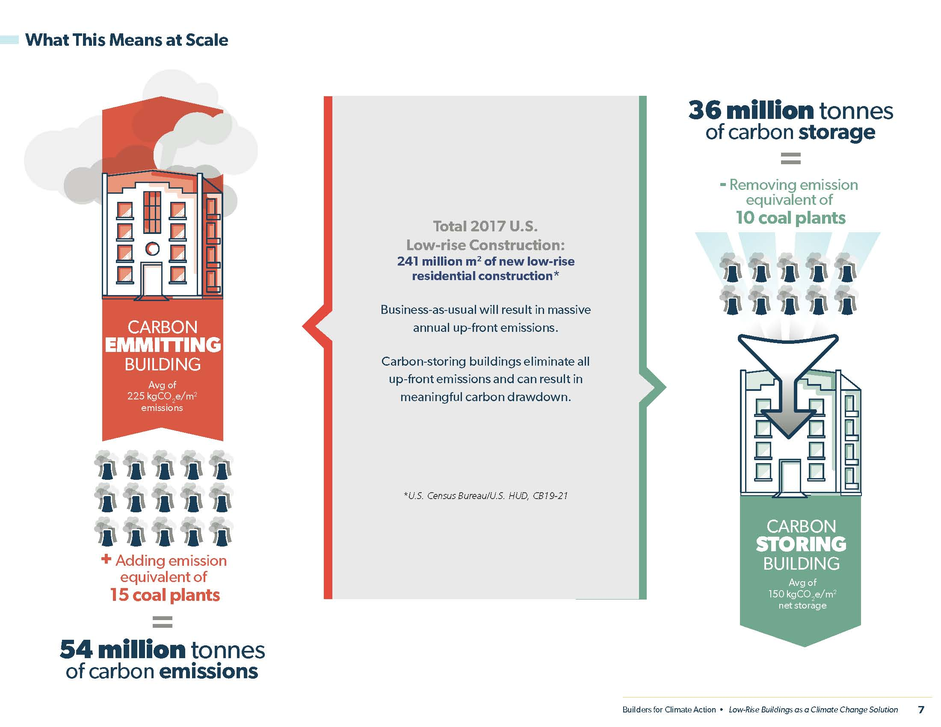
2019
Scale of potential shift from B-a-U to carbon storage in low-rise residential construction could be ~90 million tonnes annually

Slide 4
2019
Co-developed first material emissions incentive program in North America. Douro-Dummer Township sets 75 kgCO2e/m2 threshold for refund of permit fees, a $2,500 incentive.
In 2021, federal grant intended to increase this to $10,000 incentive.

Slide 5
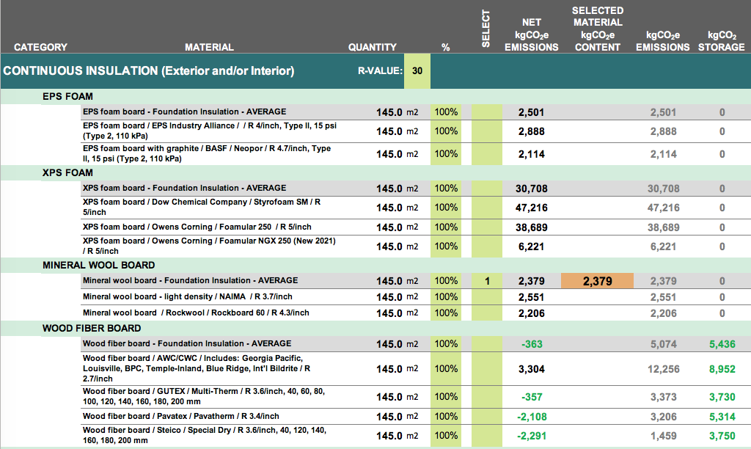
2019
Spreadsheet calculator developed and beta-tested by 30+ users in the design, construction and energy-modeling sectors.

Slide 6
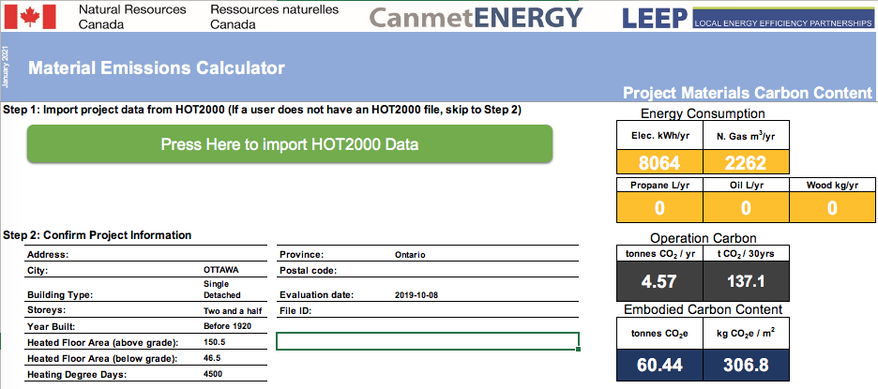
2019
Spreadsheet calculator developed for Natural Resources Canada (NRCan) to be part of their HOT2000 energy modeling software suite.
Spreadsheet calculator developed for MASS CEC Triple Decker Design Challenge

Slide 7
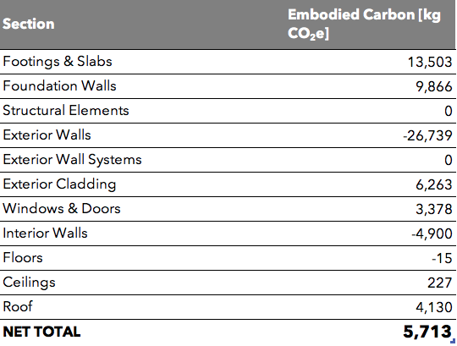
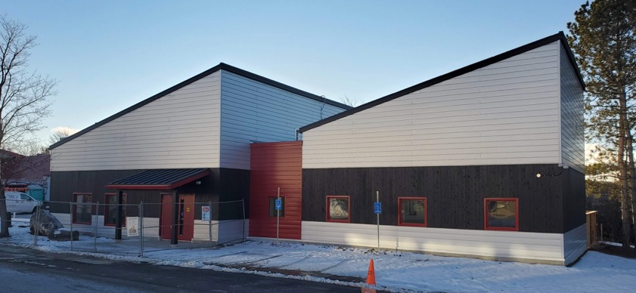
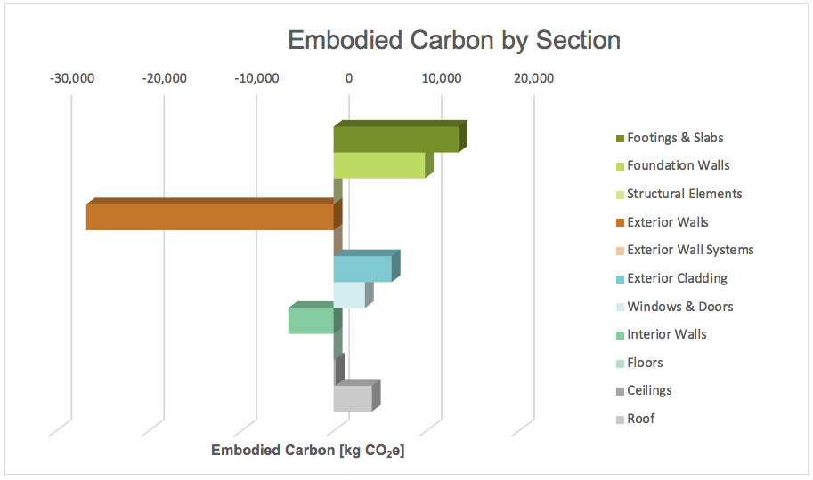
2019-2020
BEAM calculator used to develop plans for carbon storing classroom facility at Trent University, achieving 13 kgCO₂e/m² of net emissions. Project seeking ILFI Zero Carbon Certification.

Slide 8
EMBARC
Emissions from Materials Benchmark
Assessment of Residential Construction
2020-2021
Received grant from The Atmospheric Fund to conduct a material emissions benchmark study of residential construction in the Toronto region.
Will put 100+ new buildings through the BEAM calculator and produce comprehensive report for policy makers and developers/designers/builders.

Slide 9
2021
Begin study of NRCan residential archetype buildings at all step levels of National Energy Code. Report on the range of material emissions outcomes and the relationship to operational emissions. First step to inclusion of material emissions in National Building Code

Slide 10
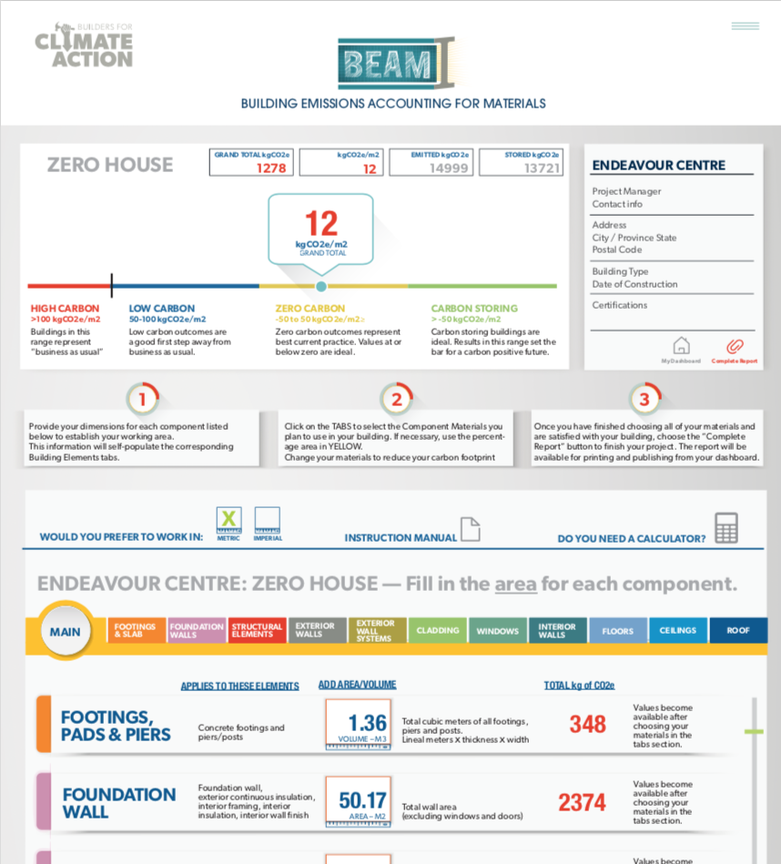
April 2021…
Launch of online version of BEAM calculator and membership website.

Slide 11
2021…
Grow membership of Builders for Climate Action
Calculator access & training
Member portal to “show off” projects and reach customers
Member forum and support
Webinars & education
Design & construction resources
Policy support and program development
Assist municipal, state and federal government initiatives
Student outreach and support
Networking with Carbon Leadership Forum members
Support carbon-storing material research & development

